Slide 1
Class 7
BUS 696
Prof. Jonathan Hersh

Slide 2
BUS 696: Class 7 Announcements
Pset 5 solutions
Problem Set 6 Posted
Final Project
Qs?
General Questions?

Slide 3
BUS 696: Class 7 Outline
AI in the News
K-Fold Cross-Validation
Bootstrapping
Variable Selection
Best Subset Selection (Don’t use)
Forward and Backward Model Selection
Primer on Optimization
Ridge Regression

Slide 4
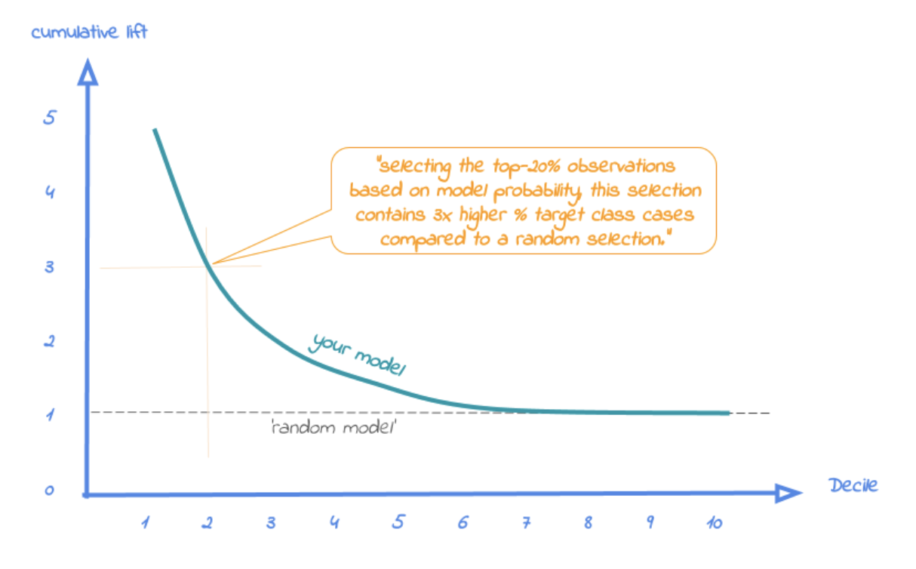
modelplotr R package: Cumulative Lift
https://modelplot.github.io/intro_modelplotr.html

Slide 5
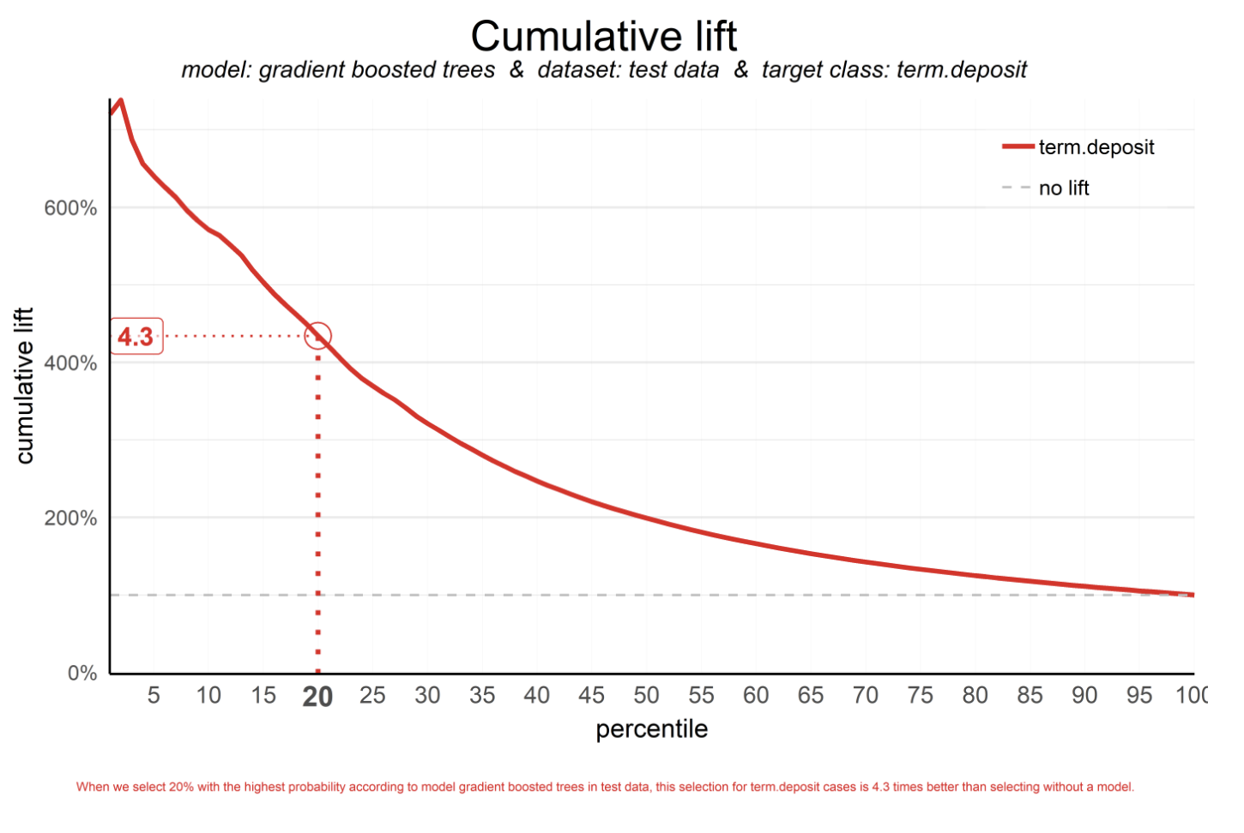
modelplotr R package: Cumulative Lift
https://modelplot.github.io/intro_modelplotr.html

Slide 6
modelplotr R package: Cumulative Lift
https://modelplot.github.io/intro_modelplotr.html

Slide 7
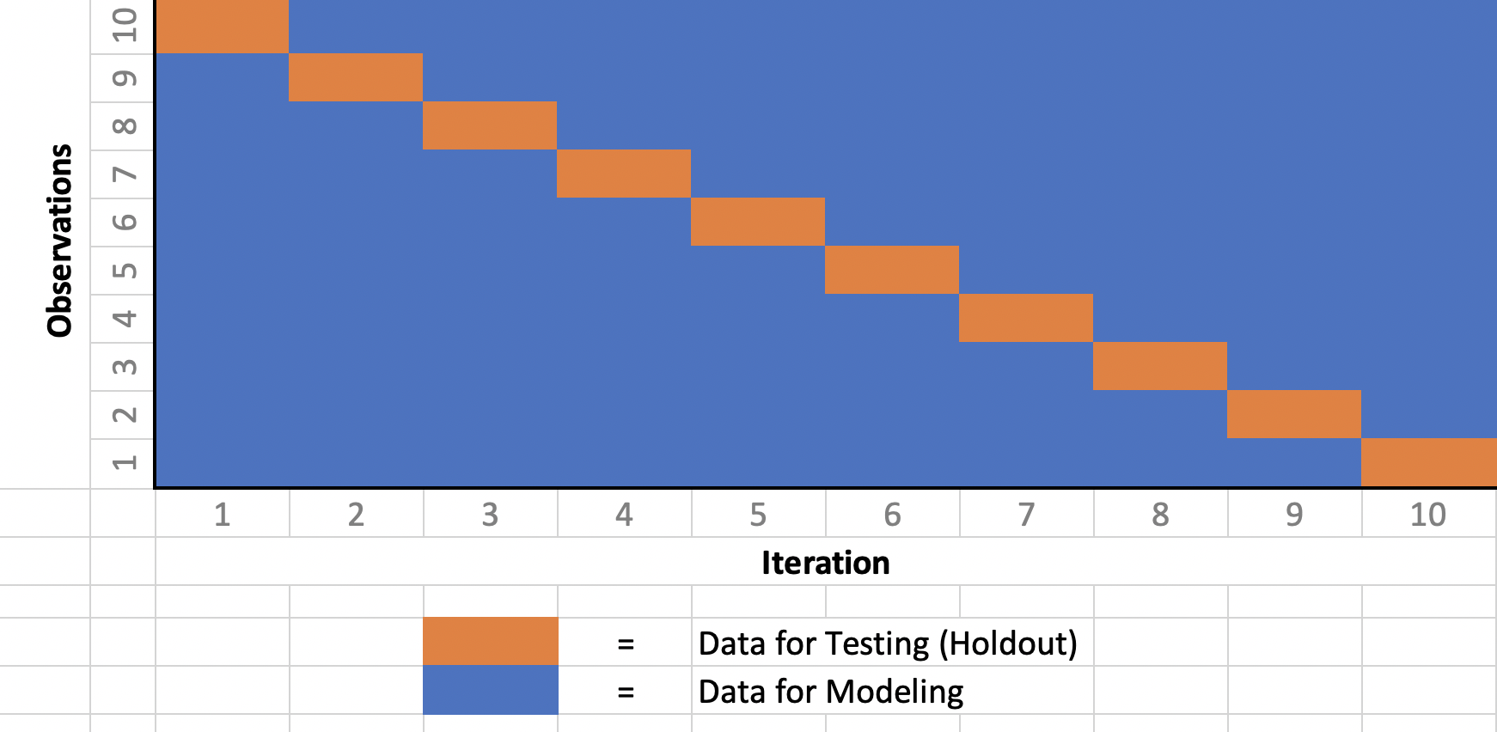
Leave-One-Out Cross-Validation

Slide 8
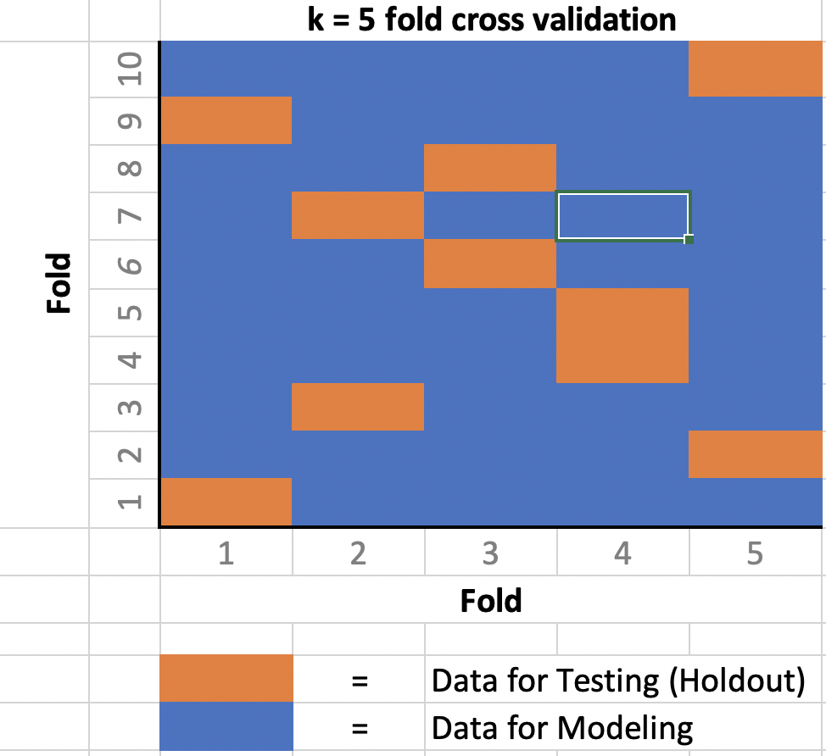
K-Fold Cross-Validation
Similar to LOOCV, but we first partition (divide) data into K distinct groups
Fit a model using data excluding group 1, use that model to predict into group 1.
Fit a model using data excluding group 2, etc
Proceed until we have yhats for every group

Slide 9
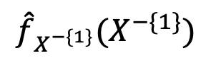
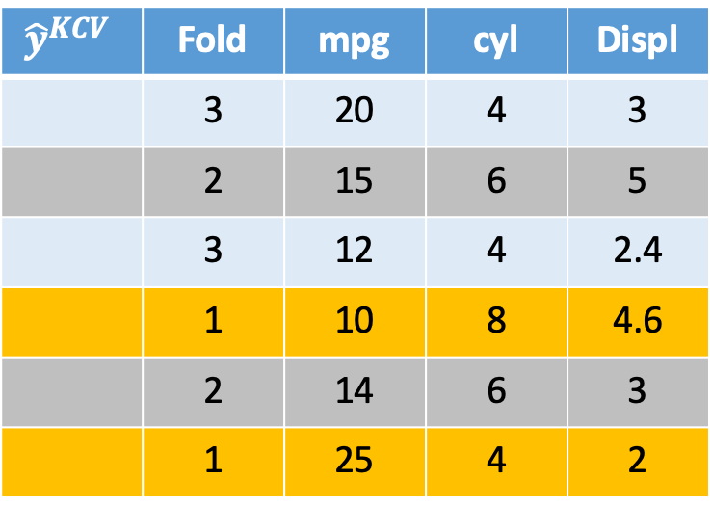
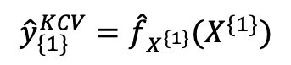
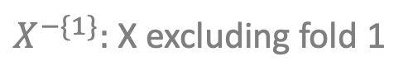
Resampling: K-Fold Cross-Validation
We start by randomly assigning each data point to one of k folds
Here we are setting k = 3
We fit a model excluding data from fold 1
That model is used to predict into fold 1
$${\hat{y}}^{KCV}$$ | Fold | mpg | cyl | Displ
 | 3 | 20 | 4 | 3
 | 2 | 15 | 6 | 5
 | 3 | 12 | 4 | 2.4
 | 1 | 10 | 8 | 4.6
 | 2 | 14 | 6 | 3
 | 1 | 25 | 4 | 2
$${\hat{f}}_{X^{−\{1\}}}(X^{−\{1\}})$$
11
$${{\hat{y}}_{\{1\}}^{KCV}=\hat{f}}_{X^{\{1\}}}(X^{\{1\}})$$
22
$X^{−\{1\}}:$ X excluding fold 1

Slide 10
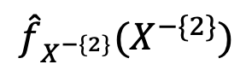
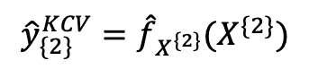

Resampling: K-Fold Cross-Validation
Here we are setting k = 3
Next we fit a model excluding observations in fold 2
That model is used to predict into fold 2
$${\hat{y}}^{KCV}$$ | Fold | mpg | cyl | Displ
 | 3 | 20 | 4 | 3
 | 2 | 15 | 6 | 5
 | 3 | 12 | 4 | 2.4
 | 1 | 10 | 8 | 4.6
 | 2 | 14 | 6 | 3
 | 1 | 25 | 4 | 2
18
$${\hat{f}}_{X^{−\{2\}}}(X^{−\{2\}})$$
11
15
$${{\hat{y}}_{\{2\}}^{KCV}=\hat{f}}_{X^{\{2\}}}(X^{\{2\}})$$
22
$X^{−\{2\}}:$ X excluding fold 2

Slide 11
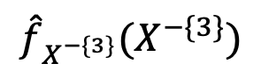
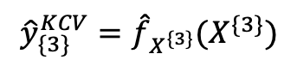
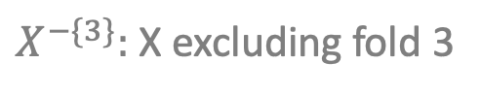
Resampling: K-Fold Cross-Validation
Here we are setting k = 3
Next we fit a model excluding observations in fold 3
That model is used to predict into fold 3
$${\hat{y}}^{KCV}$$ | Fold | mpg | cyl | Displ
 | 3 | 20 | 4 | 3
 | 2 | 15 | 6 | 5
 | 3 | 12 | 4 | 2.4
 | 1 | 10 | 8 | 4.6
 | 2 | 14 | 6 | 3
 | 1 | 25 | 4 | 2
22
18
12
$${\hat{f}}_{X^{−\{3\}}}(X^{−\{3\}})$$
11
15
$${{\hat{y}}_{\{3\}}^{KCV}=\hat{f}}_{X^{\{3\}}}(X^{\{3\}})$$
22
$X^{−\{3\}}:$ X excluding fold 3

Slide 12
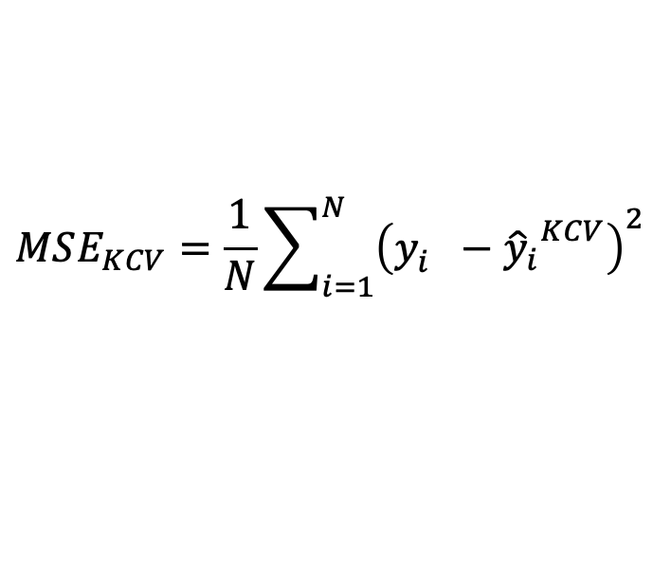
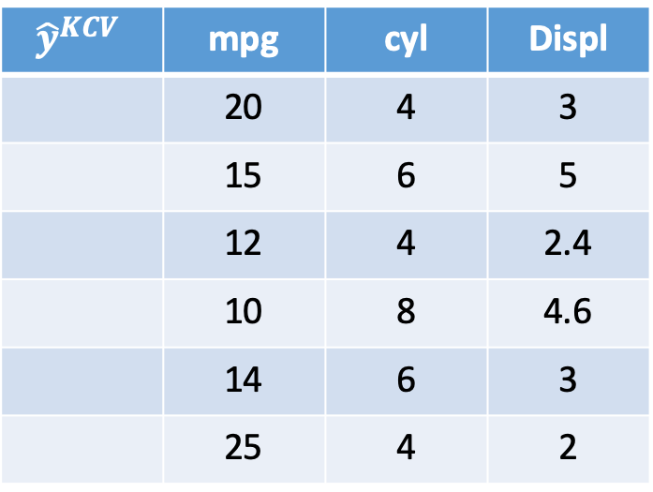
K-Fold CV Versus LOOCV
Advantages of K-Fold CV over LOOCV
Only need to estimate K models
Disadvantages
Higher variance (more uncertainty in y_hats)
Because of computational cost K-Fold CV more commonly used
$${\hat{y}}^{KCV}$$ | mpg | cyl | Displ
 | 20 | 4 | 3
 | 15 | 6 | 5
 | 12 | 4 | 2.4
 | 10 | 8 | 4.6
 | 14 | 6 | 3
 | 25 | 4 | 2
18
16
12
11
11
22
$$MSE_{KCV}=\frac{1}{N}\sum_{i=1}^{N}{{\left(y_{i}^{}−{{\hat{y}}_{i}}^{KCV}\right)}^{2}}$$

Slide 13
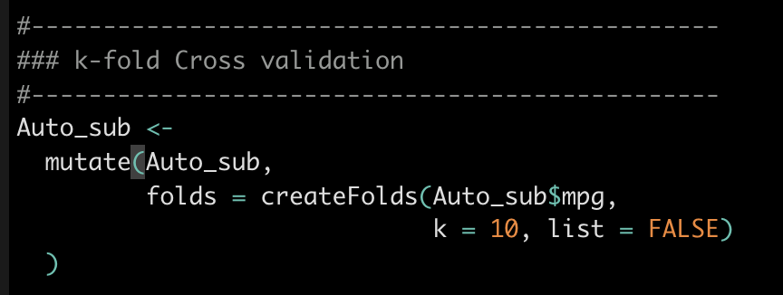
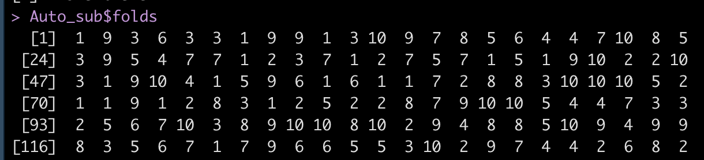
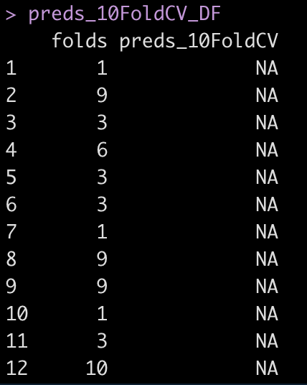
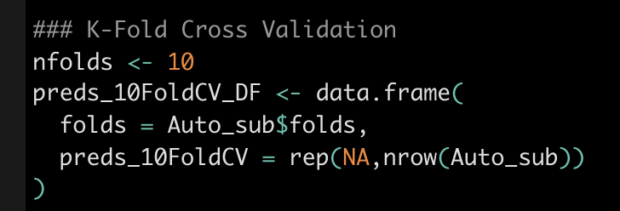
K-Fold Cross-Validation in R

Slide 14
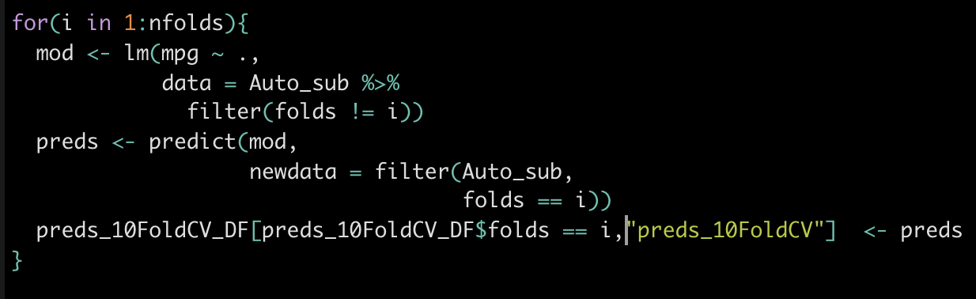
K-Fold Cross-Validation in R
 | RMSE (pred vs true) | R2 (pred vs true)
In-Sample | 3.293 | 0.8215
LOOCV | 3.382 | 0.8118
10 Fold CV | 3.357 | 0.8147
On average 10-Fold CV diagnostic measures will be in-between in-sample measures and LOOCV measures.

Slide 15
BUS 696: Class 7 Outline
AI in the News
K-Fold Cross-Validation
Bootstrapping
Variable Selection
Best Subset Selection (Don’t use)
Forward and Backward Model Selection
Primer on Optimization
Ridge Regression

Slide 16
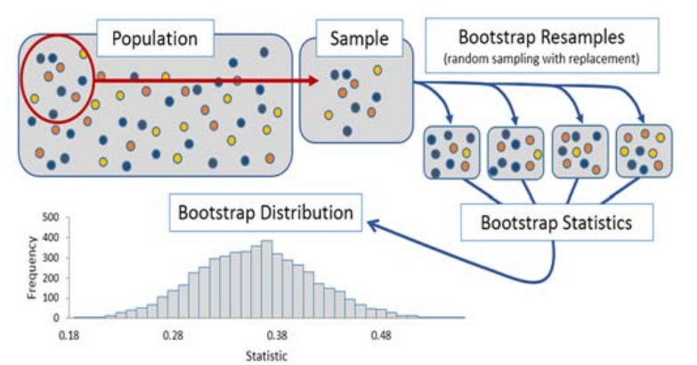
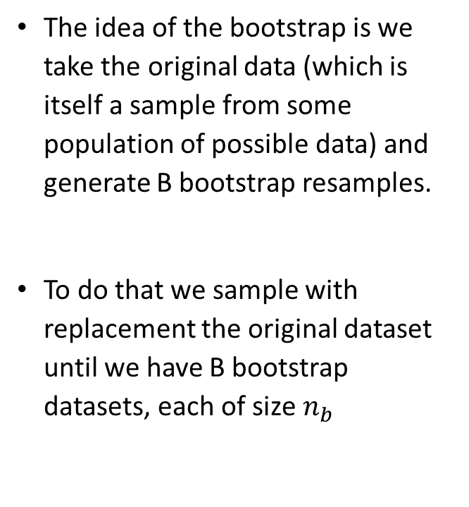
Bootstrap
The idea of the bootstrap is we take the original data (which is itself a sample from some population of possible data) and generate B bootstrap resamples.
To do that we sample with replacement the original dataset until we have B bootstrap datasets, each of size $n_{b}$

Slide 17
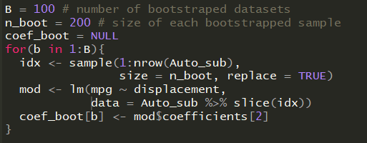
Bootstrapping in R
Again, many ways to do it. First we do it by hand.

Slide 18
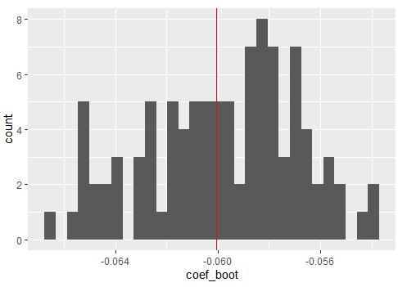
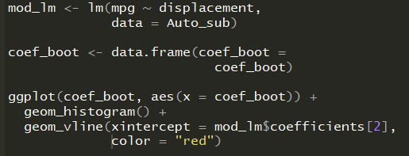
Bootstrapping in R
Linear model coefficient on original sample
Each point shows a coefficient from a different bootstrapped sample

Slide 19
BUS 696: Class 7 Outline
AI in the News
K-Fold Cross-Validation
Bootstrapping
Variable Selection
Best Subset Selection (Don’t use)
Forward and Backward Model Selection
Primer on Optimization
Ridge Regression

Slide 20

Variable Selection (Sometimes Called Model Selection)
Which Xs to include in our models?
Including too many variables -> high variance –> model overfit
Three solutions
Subset selection
Shrinkage (Lasso, Ridge, and Elastic-Net)
Dimension Reduction

Slide 21
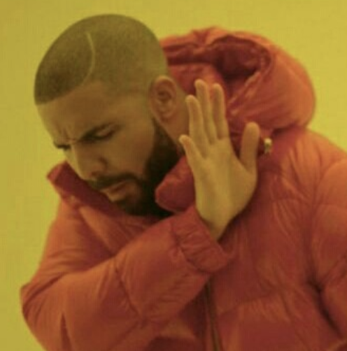


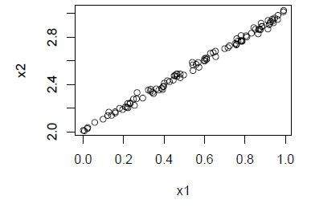
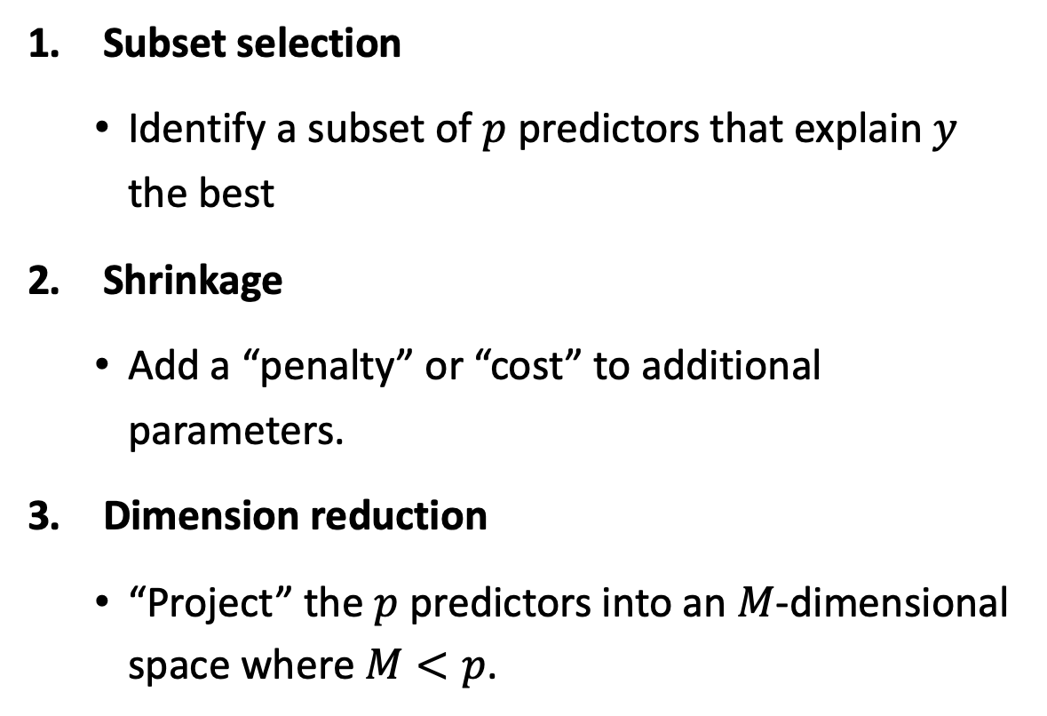
Solutions to feature selection problem
Subset selection
Identify a subset of $p$ predictors that explain $y$ the best
Shrinkage
Add a “penalty” or “cost” to additional parameters.
Dimension reduction
“Project” the $p$ predictors into an $M$-dimensional space where $M<p$.

Slide 22
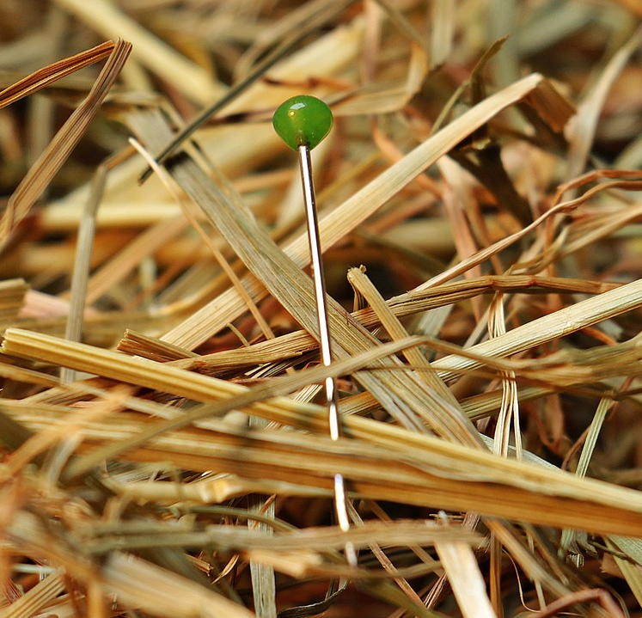
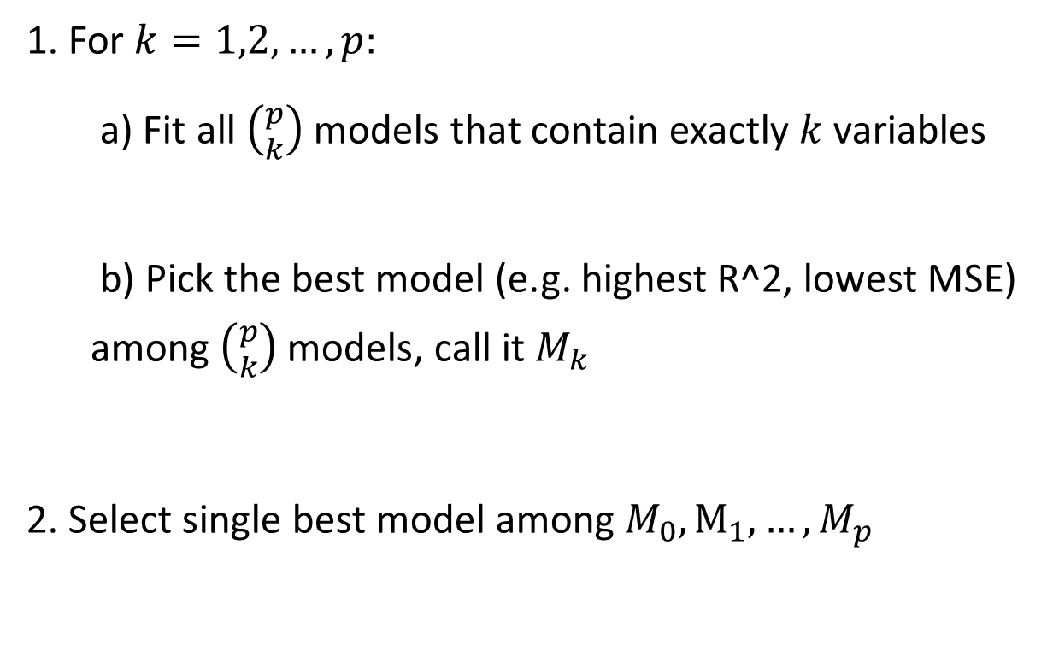
Best subset selection algorithm
1. For $k=1,2,…,p:$
a) Fit all $\left({p \atop k}\right)$ models that contain exactly $k$ variables
b) Pick the best model (e.g. highest R^2, lowest MSE) among $\left({p \atop k}\right)$ models, call it $M_{k}$
2. Select single best model among $M_{0},M_{1},…,M_{p}$

Slide 23
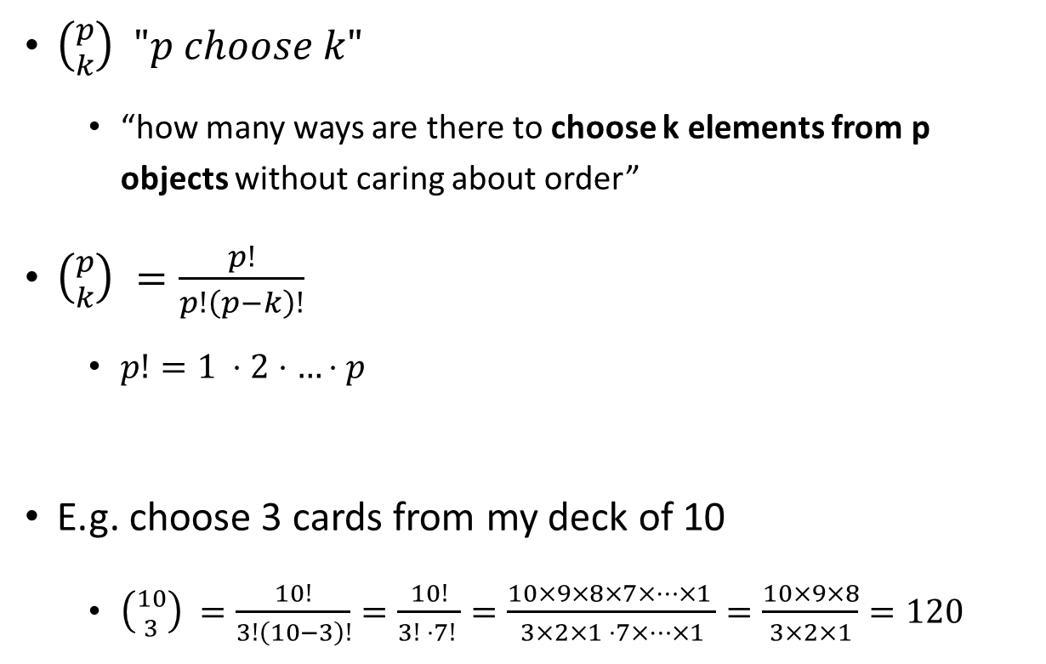
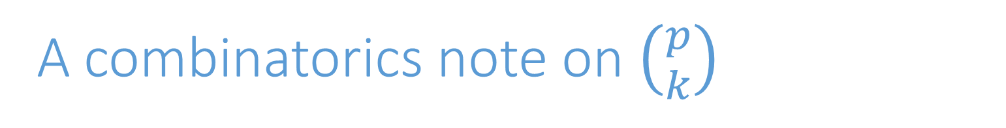
A combinatorics note on $\left({p \atop k}\right)$
$\left({p \atop k}\right) "p choose k"$
“how many ways are there to choose k elements from p objects without caring about order”
$\left({p \atop k}\right) =\frac{p!}{p!\left(p−k\right)!}$
$p!=1 ⋅2⋅…⋅p$
E.g. choose 3 cards from my deck of 10
$\left({10 \atop 3}\right) =\frac{10!}{3!\left(10−3\right)!}=\frac{10!}{3! ⋅7! }=\frac{10×9×8×7×…×1 }{3×2×1 ⋅7×…×1}=\frac{10×9×8}{3×2×1}=120$

Slide 24
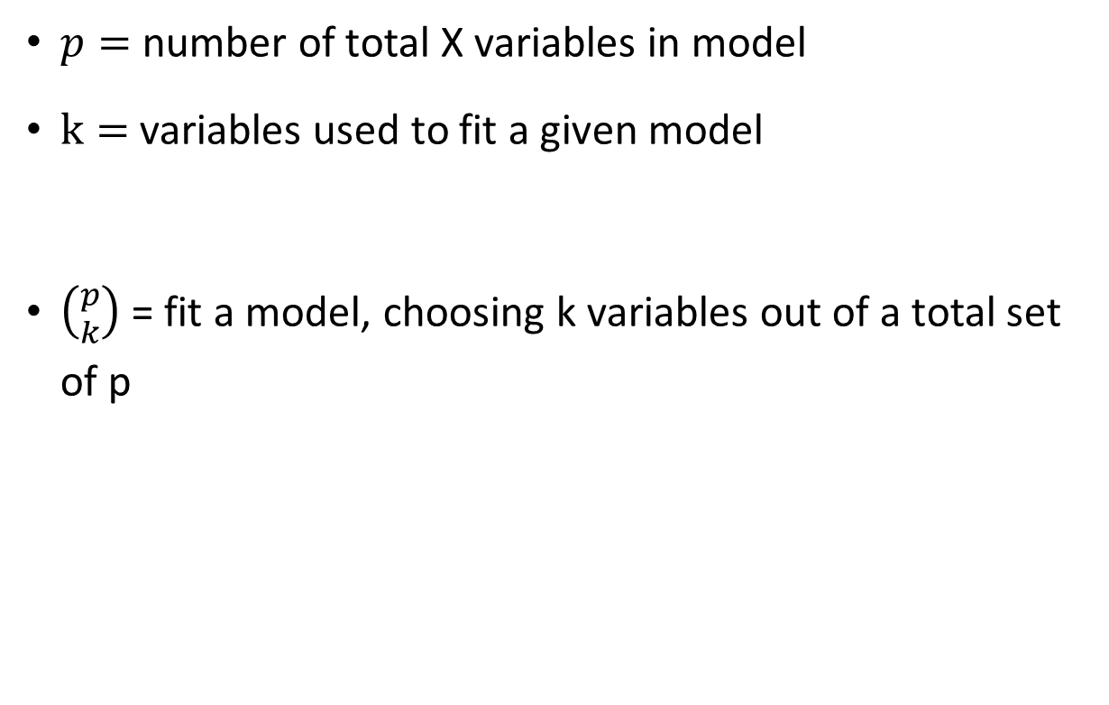
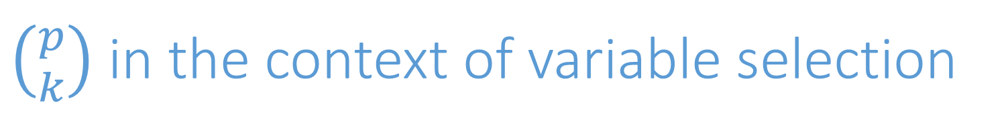
$\left({p \atop k}\right)$ in the context of variable selection
$p=$ number of total X variables in model
$k=$ variables used to fit a given model
$\left({p \atop k}\right)$ = fit a model, choosing k variables out of a total set of p

Slide 25

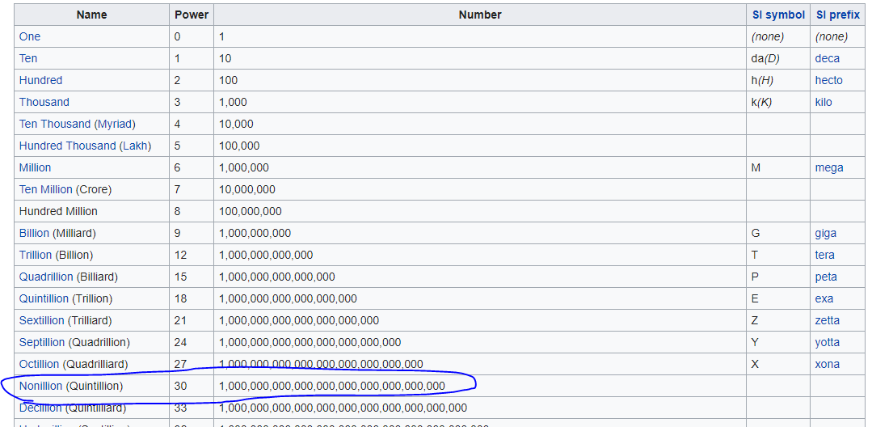

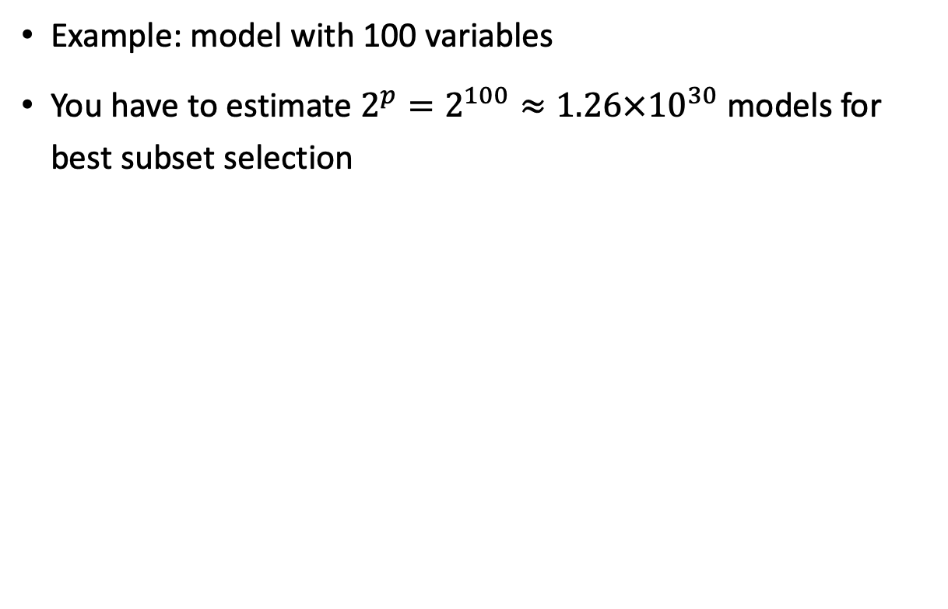
Why is best subset selection not a good idea?
Example: model with 100 variables
You have to estimate $2^{p}=2^{100}≈1.26×{10}^{30}$ models for best subset selection

Slide 26
BUS 696: Class 7 Outline
AI in the News
K-Fold Cross-Validation
Bootstrapping
Variable Selection
Best Subset Selection (Don’t use)
Forward and Backward Model Selection
Primer on Optimization
Ridge Regression

Slide 27
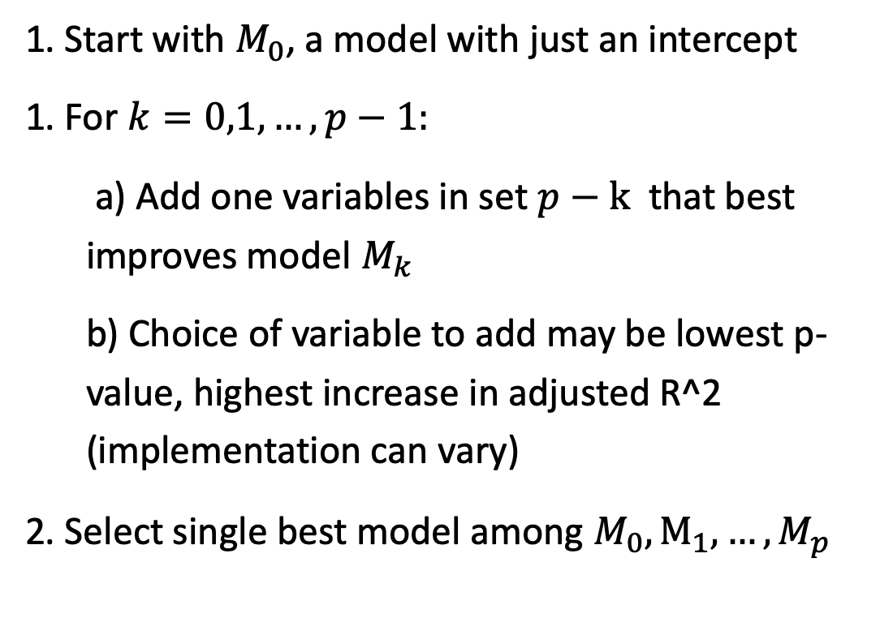
Forward stepwise algorithm
1. Start with $M_{0}$, a model with just an intercept
1. For $k=0,1,…,p−1:$
a) Add one variables in set $p−k$ that best improves model $M_{k}$
b) Choice of variable to add may be lowest p-value, highest increase in adjusted R^2 (implementation can vary)
2. Select single best model among $M_{0},M_{1},…,M_{p}$

Slide 28
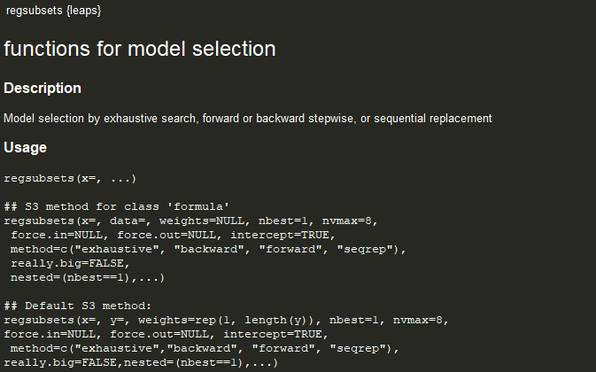
leaps package – regsubsets() function

Slide 29
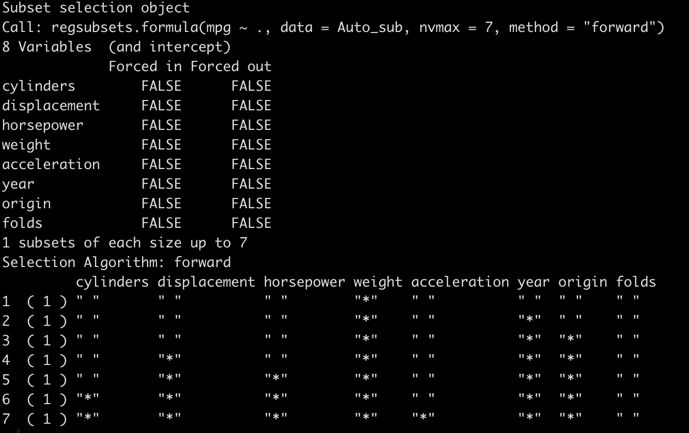
Regsubsets() forward selection

Slide 30
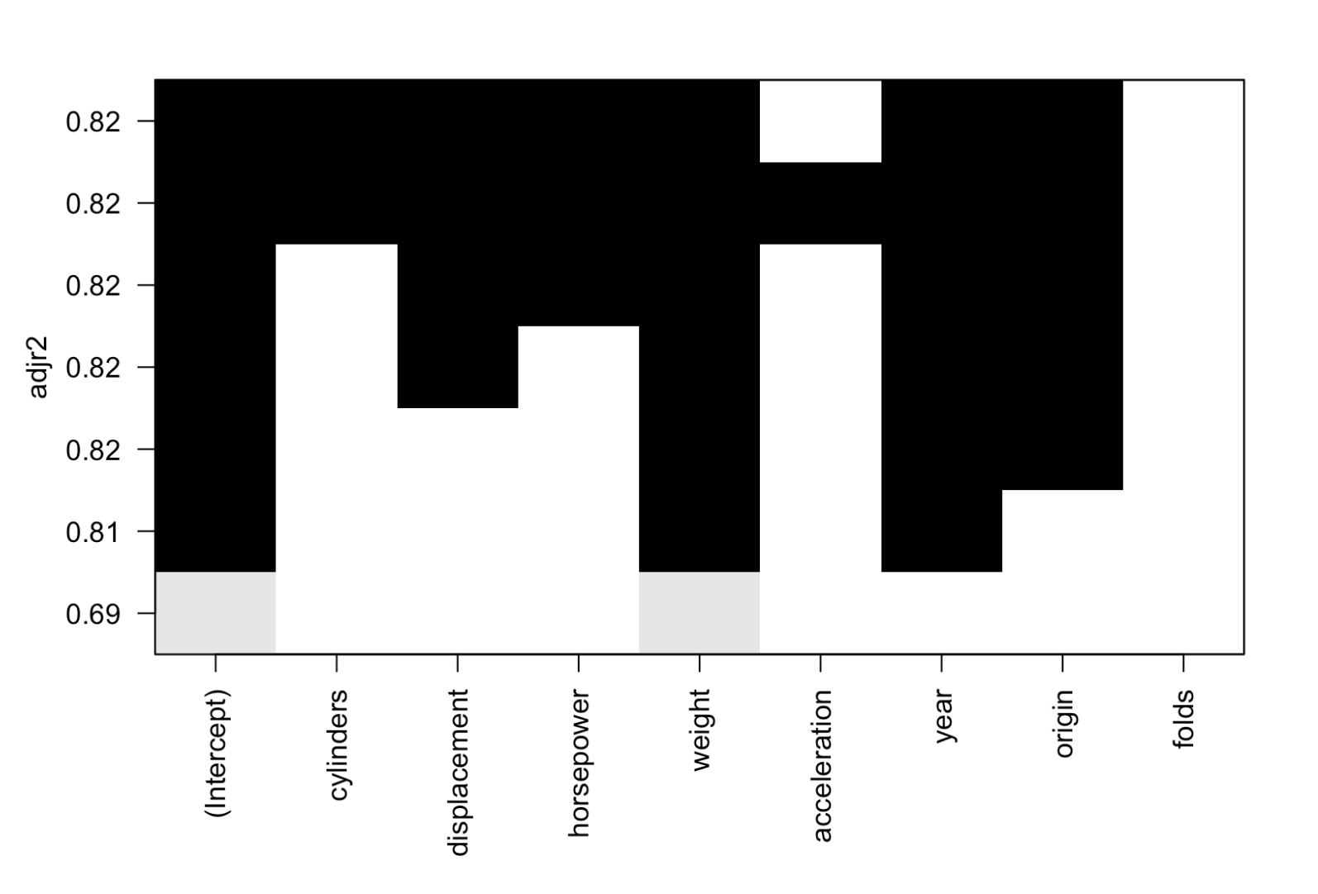
Plot Summary of Forward Model Selection

Slide 31
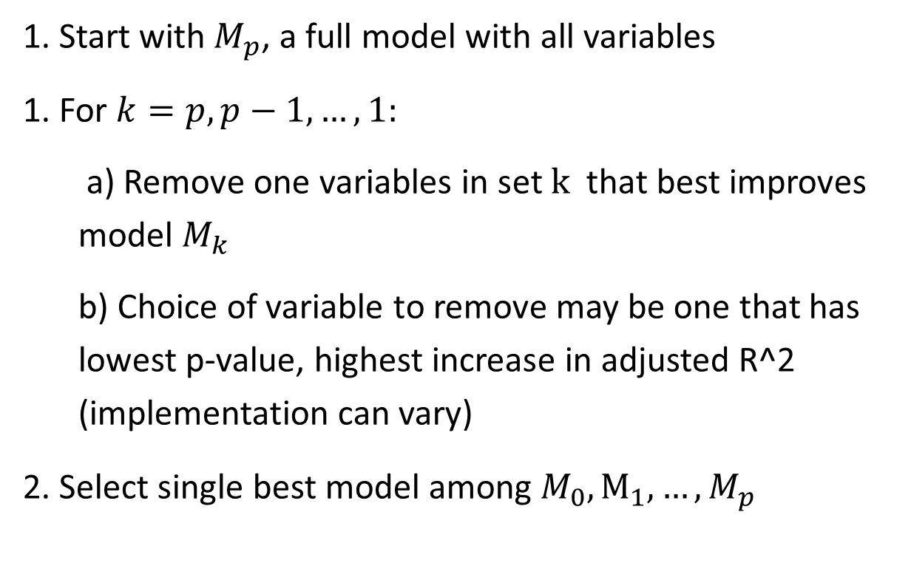
Backwards stepwise algorithm
1. Start with $M_{p}$, a full model with all variables
1. For $k=p,p−1,…,1:$
a) Remove one variables in set $k$ that best improves model $M_{k}$
b) Choice of variable to remove may be one that has lowest p-value, highest increase in adjusted R^2 (implementation can vary)
2. Select single best model among $M_{0},M_{1},…,M_{p}$

Slide 32
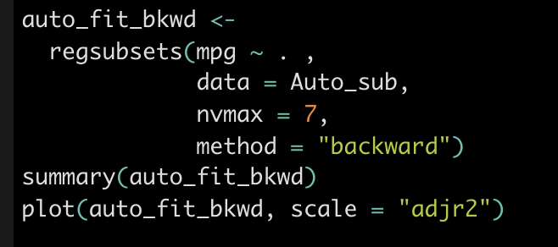
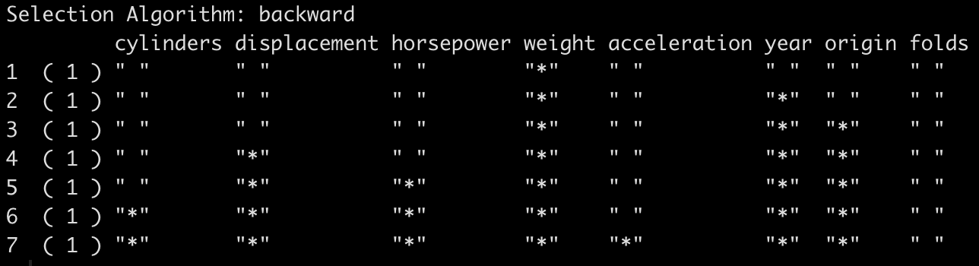
Regsubsets backward selection

Slide 33
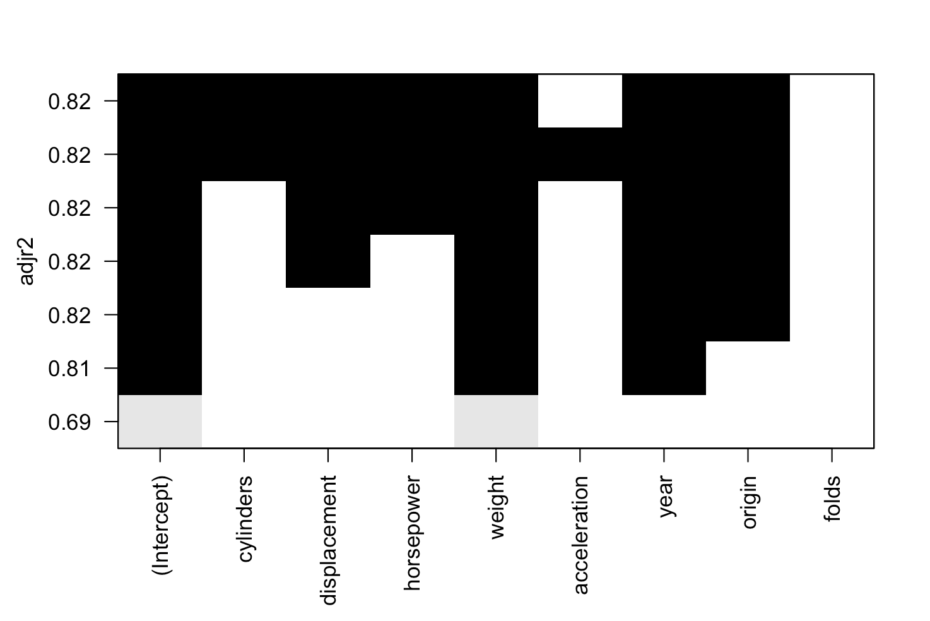
Plot Summary of Backward Model Selection

Slide 34
Pros/cons of forward stepwise
Pros
Quick for small datasets with small p
Can overfit if don’t cross validate over some selection mechanism (i.e. # of max variables to use in model, p-value selection criteria
Cons
Doesn’t work well in the presence of multicollinearity
Not guaranteed best solution (aka global maximum)

Slide 35
BUS 696: Class 7 Outline
AI in the News
K-Fold Cross-Validation
Bootstrapping
Variable Selection
Best Subset Selection (Don’t use)
Forward and Backward Model Selection
Primer on Optimization
Ridge Regression

Slide 36
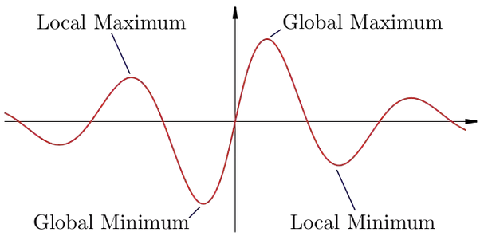
Global versus local maximum

Slide 37
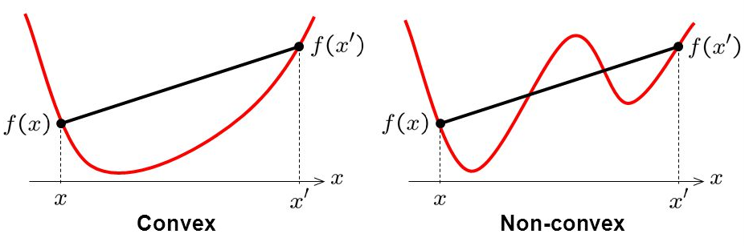
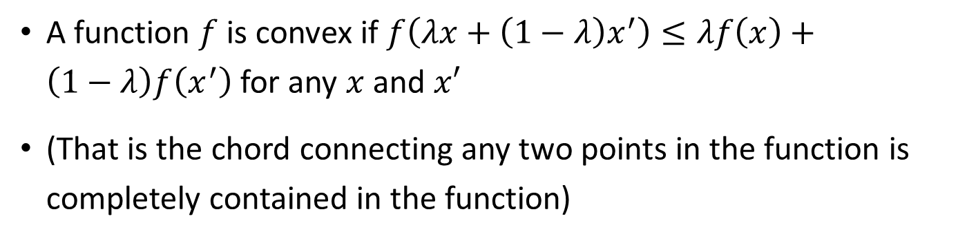
Convex versus non-convex function
A function $f$ is convex if $f\left(λx+\left(1−λ\right)x^{′}\right)≤λf\left(x\right)+\left(1−λ\right)f\left(x^{′}\right)$ for any $x$ and $x′$
(That is the chord connecting any two points in the function is completely contained in the function)

Slide 38
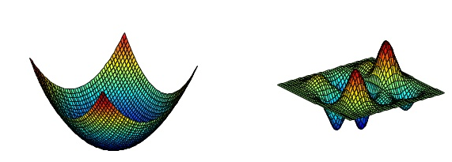
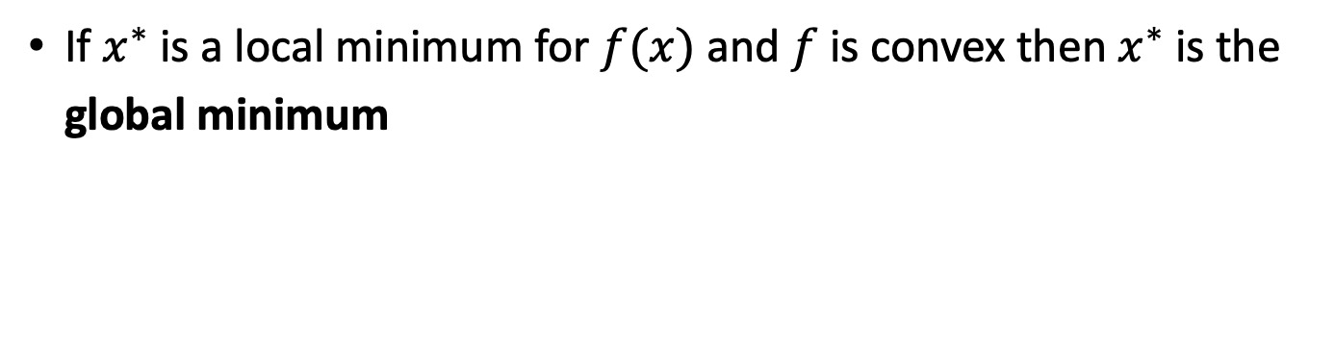
Sufficiency for global versus local minimum
If $x^{∗}$ is a local minimum for $f(x)$ and $f$ is convex then $x^{∗}$ is the global minimum

Slide 39

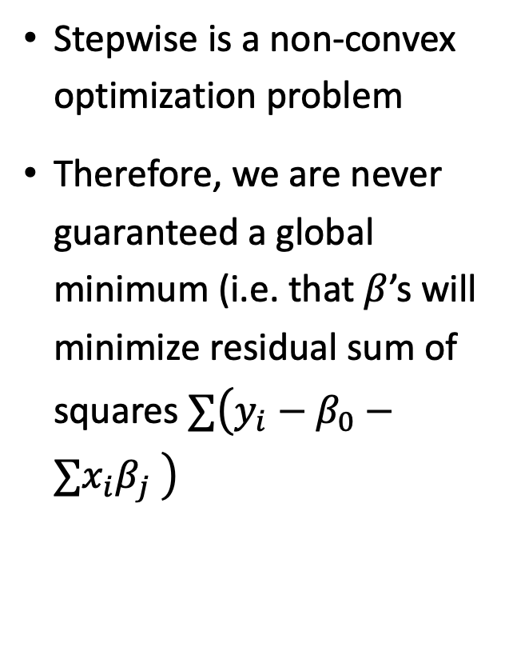
What does this mean for stepwise selection?
Stepwise is a non-convex optimization problem
Therefore, we are never guaranteed a global minimum (i.e. that $β$’s will minimize residual sum of squares $∑\left(y_{i}−β_{0}−{∑x}_{i}β_{j} \right)$

Slide 40
BUS 696: Class 7 Outline
AI in the News
K-Fold Cross-Validation
Bootstrapping
Variable Selection
Best Subset Selection (Don’t use)
Forward and Backward Model Selection
Primer on Optimization
Ridge Regression

Slide 41


Least Squares (OLS Estimator)
Beta_hat “solves” (e.g. is the argument that minimizes) the objective function
$$\hat{β}=\underset{β}{argmin}\left\{\sum_{i=1 }^{N}{{\left(y_{i}−β_{0}−\sum_{j=1}^{K}{x_{ij}}β_{j}\right)}^{2}}\right\}$$
$$\hat{β}\underset{}{minimizes:}\left\{\sum_{i=1 }^{N}{{\left(y_{i}−β_{0}−\sum_{j=1}^{K=1}{x_{ij}}β_{j}\right)}^{2}}\right\}$$

Slide 42



Least Squares (OLS Estimator)
$$\hat{β}minimizes:{\sum_{i=1 }^{N}{{\left(y_{i}−β_{0}−x_{i1}β_{1}\right)}^{2}}}$$
Let’s set K = 1 (i.e. one explanatory variable to make this easier)
Least squares minimizes the sum of squared residuals (e.g. $y_{i}−\hat{y}$)
Visually, the slope ($β_{1}$) minimizes the difference between the points and the yellow line (red lines)
Y
X

Slide 43


Ridge Regression Idea
Ridge regression in contrast minimizes the OLS residuals plus the squared slope of beta times $λ$
$${\hat{β}}_{ridge}minimizes:{residuals+λ⋅{\left(β_{1}\right)}^{2}}$$
$β_{1}$
Why is this smart? Let’s take the example where we only have two data points.
Y
Our best fit line describes the points perfectly and our residuals = 0. Our bias is zero!
X

Slide 44

OLS Bias and Variance
$β_{1}$
Bias = 0, which is good
What about our variance?
Y
Imaging we had the following data in our test set
Then our test error would be the lines in red, and our variance would be high
X
training
test
Intuition: increasing bias can often reduce variance

Slide 45




Ridge Regression Idea
Now let $λ=1$. ${\hat{β}}_{ridge}$ minimizes:
residuals + $1⋅{\left(β_{1}\right)}^{2}$
= 0 + $1⋅{\left(β_{1}\right)}^{2}$
$${\hat{β}}_{ridge}minimizes:{residuals+λ⋅{\left(slope\right)}^{2}}$$
$${\hat{β}}_{OLS}$$
Suppose the OLS slope = 2
$${\hat{β}}_{ridge}$$
then ${\hat{β}}_{ridge}$ would choose to have some positive residuals to because
-residuals + 1 $⋅{\left(1\right)}^{2}$
is likely less than 0 + ${\left(2\right)}^{2}=4$
Y
X
Aka: we accept a little bias (higher residuals) for less variance (better test performance)

Slide 46




Ridge Regression and Lambda
What if we set $λ=1000?$
$${\hat{β}}_{ridge}minimizes:{residuals+λ⋅{\left(slope\right)}^{2}}$$
${\hat{β}}_{ridge}$ minimizes:
residuals + $1000⋅{\left(β_{1}\right)}^{2}$
$${\hat{β}}_{OLS}$$
Here ridge will have to accept very high residuals in order to avoid high slope penalty
Y
$${\hat{β}}_{ridge}$$
${\hat{β}}_{ridge}$ will set slope = 0 and we get:
residuals + $1000⋅{\left(0\right)}^{2}$
= residuals + 0
X
E.g. we accept a lot of bias but low variance

Slide 47




Ridge Regression and Lambda
What if we set $λ=0?$
$${\hat{β}}_{ridge}minimizes:{residuals+λ⋅{\left(slope\right)}^{2}}$$
${\hat{β}}_{ridge}$ minimizes:
residuals + $0⋅{\left(β_{1}\right)}^{2}$
= residuals
$${\hat{β}}_{ridge}$$
$${\hat{β}}_{OLS}$$
Y
That’s just the OLS estimator and ${\hat{β}}_{ridge}={\hat{β}}_{OLS}$
X
E.g. lower the penalty on lambda the closer ridge is to OLS.

Slide 48






Choosing $λ$ for Ridge?
So how do we choose $λ$?
$${\hat{β}}_{ridge}minimizes:{residuals+λ⋅{\left(slope\right)}^{2}}$$
In practice we estimate a many models with many different values of $λ$
$${{\hat{β}}^{λ=1}}_{ridge}$$
$${{\hat{β}}^{λ=2}}_{ridge}$$
We pick a min and max lambda (say 0 and 10), then choose some points in-between
Y
Our optimal $λ^{∗}$is the lambda that minimizes cross-validated error
X

Slide 49

glmnet package

Slide 50

glmnetUtils: Necessary Additional Package

Slide 51

glmnetUtils: Necessary Additional Package
Very important:
Set alpha = 0 to get ridge
alpha = 1 to estimate Lasso model (more on this later)

Slide 52

coef() function

